Slide 1

Sockets in JS/Node
As presented by G.Penkov

Slide 2
Съдържание
Какво представляват sockets?
Преглед на основите на OSI мрежови модел
IP, TCP, UDP
HTTP надстройване с WebSocket
Реални приложения и случаи на използване

Slide 3
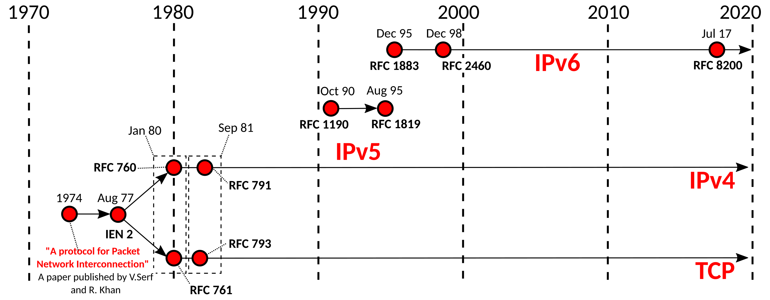
История на IP протокола

Slide 4
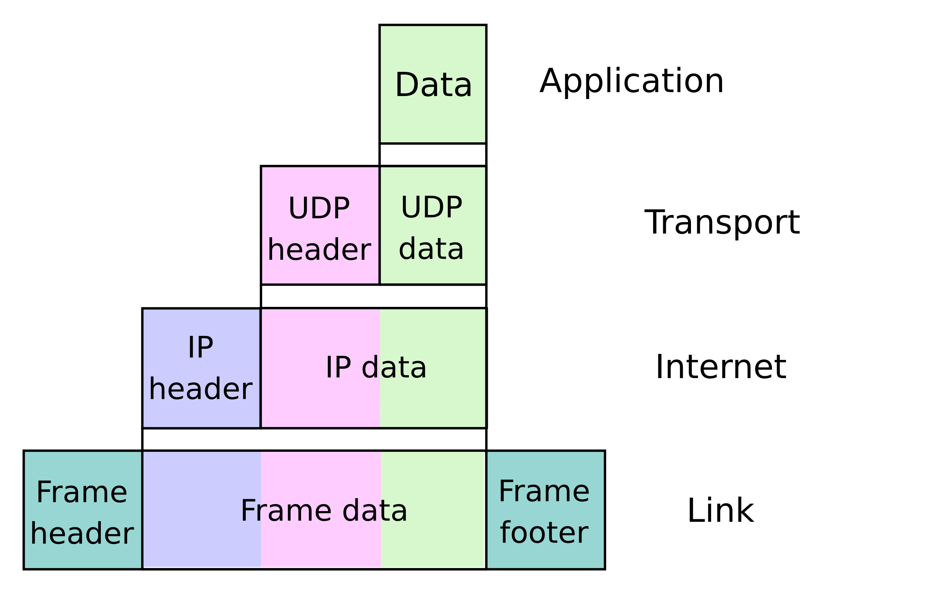
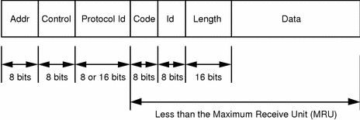

Slide 5
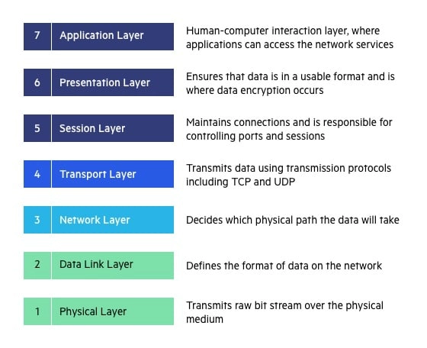

Slide 6
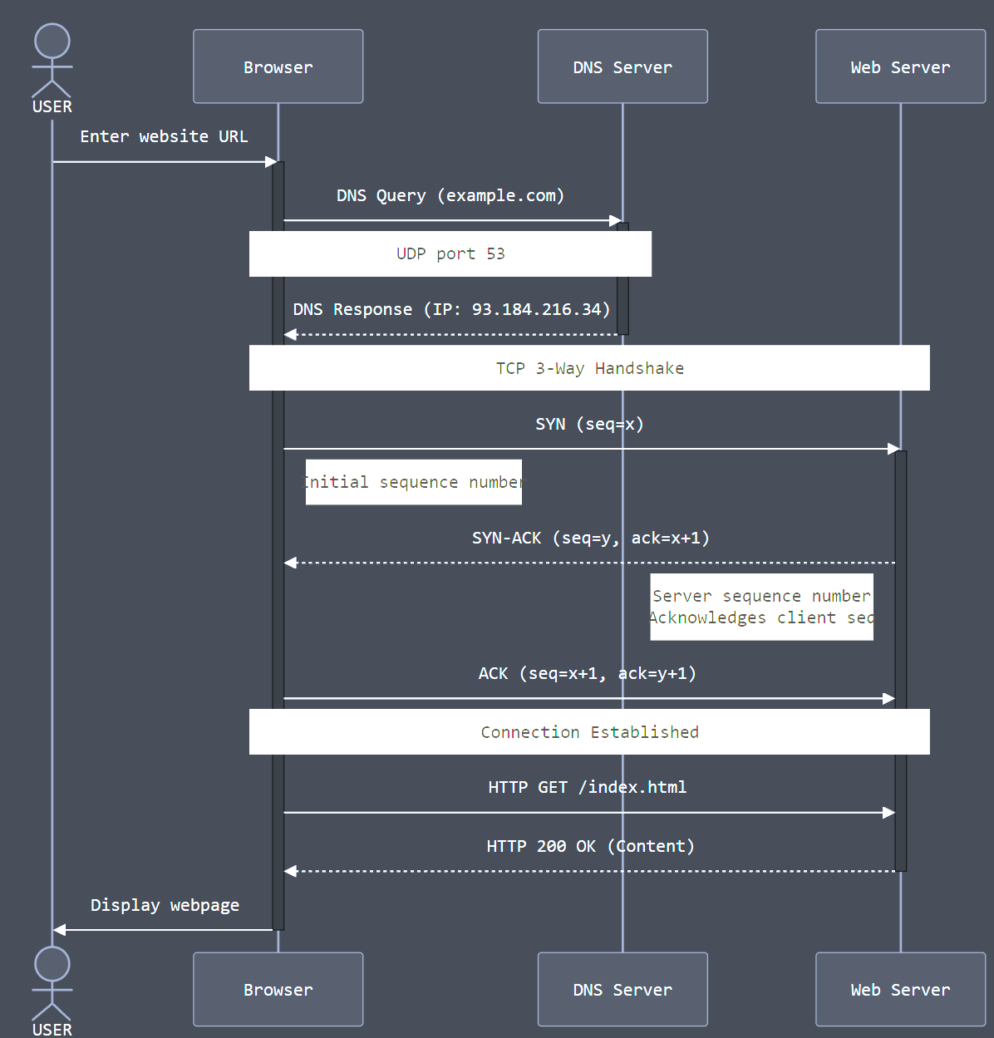
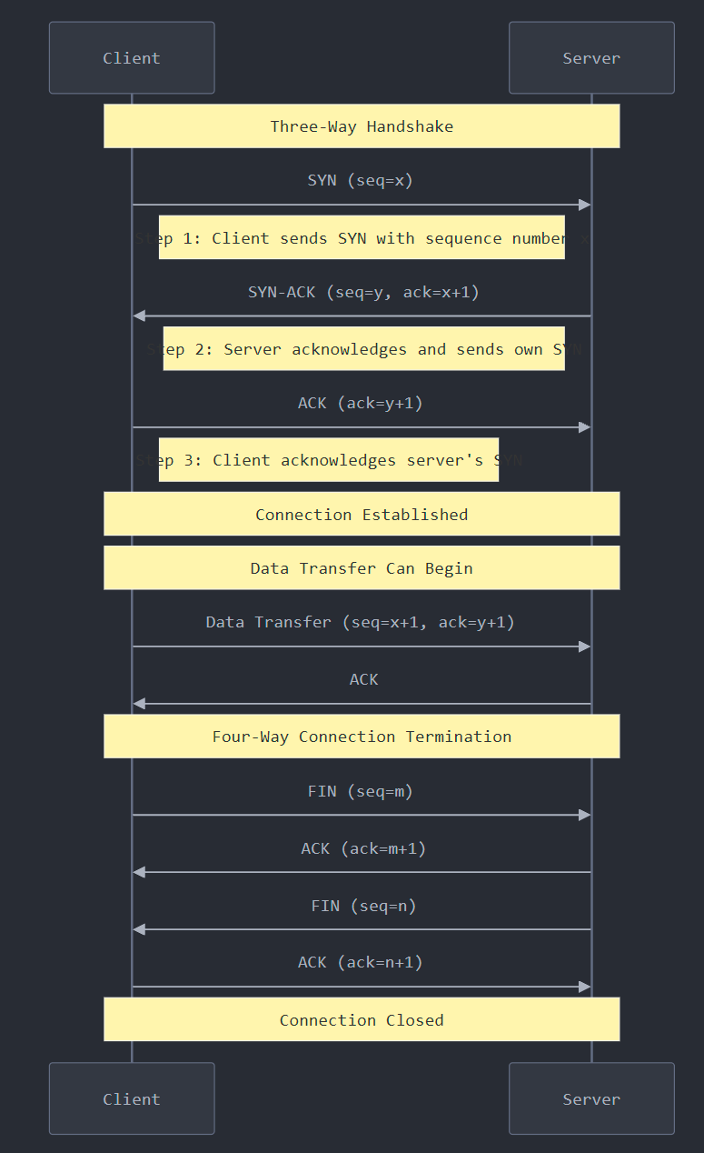
DNS resolution + connection
Three-way handshake

Slide 7
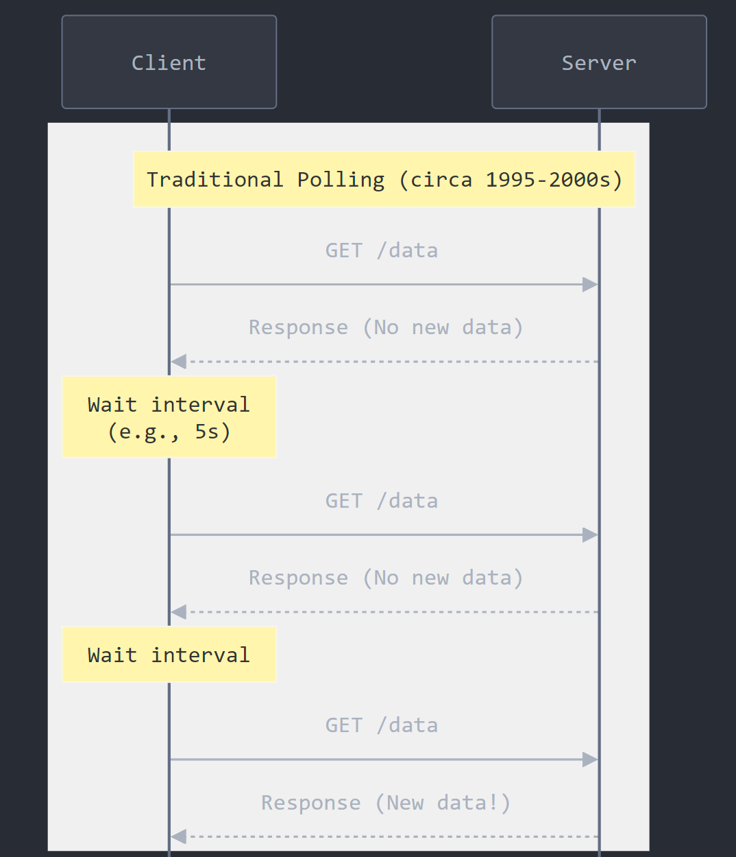
Polling - подпитване
XMLHttpRequest
function makeRequest(url, callback) {
var xhr = new XMLHttpRequest();
xhr.onreadystatechange = function() {
if (xhr.readyState === 4) {
if (xhr.status === 200) {
callback(null, xhr.responseText);
} else {
callback(new Error('Request failed: ' + xhr.status));
}
}
};
xhr.open('GET', url, true);
xhr.send();
}

Slide 8
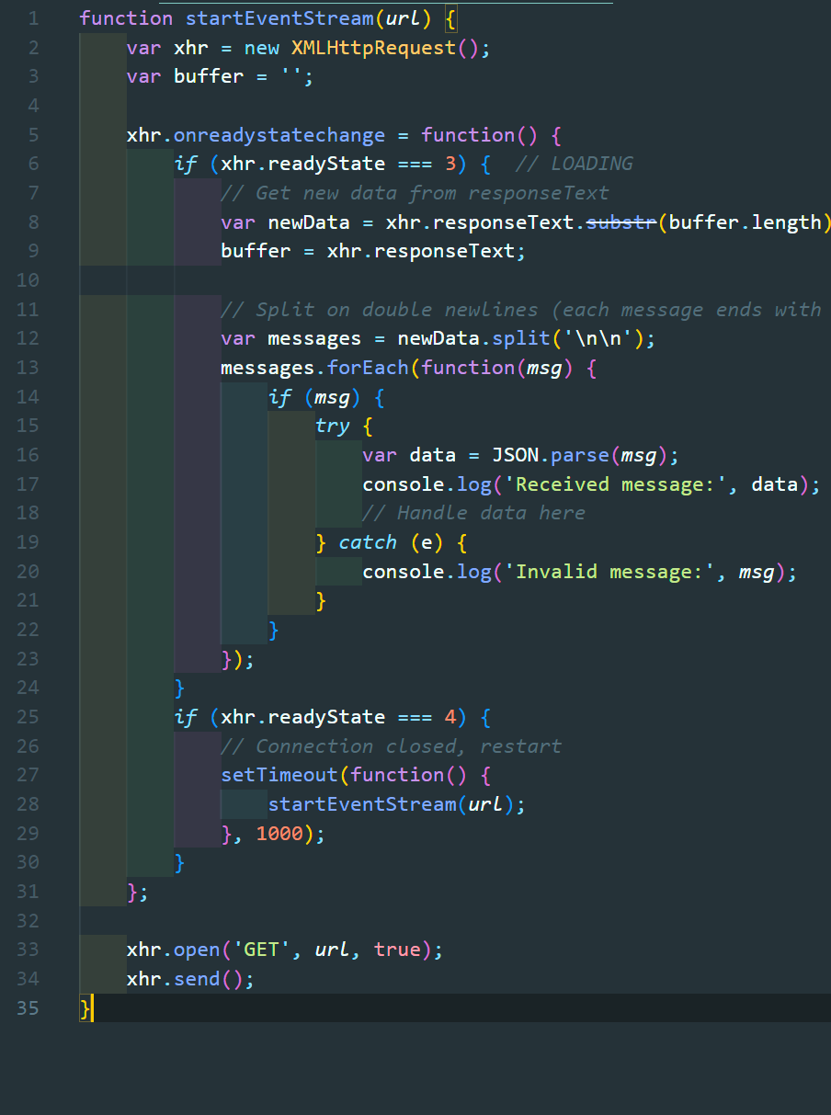
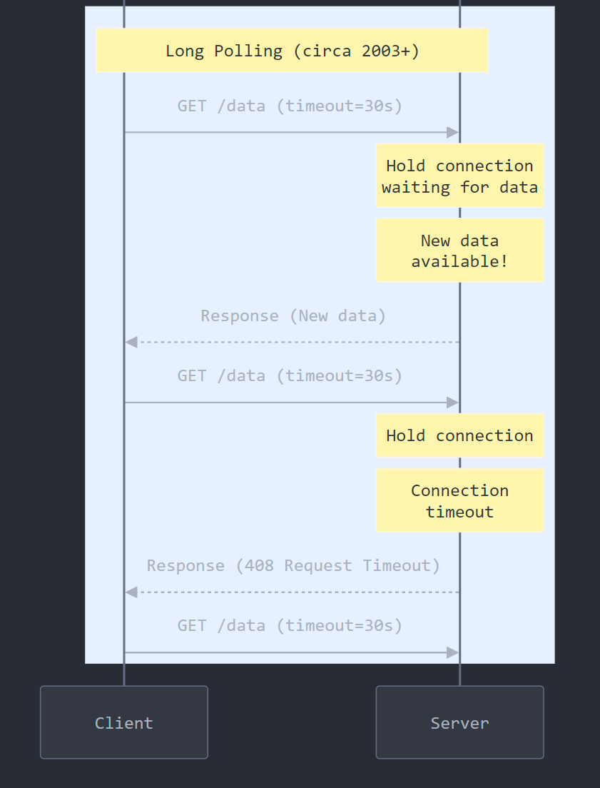
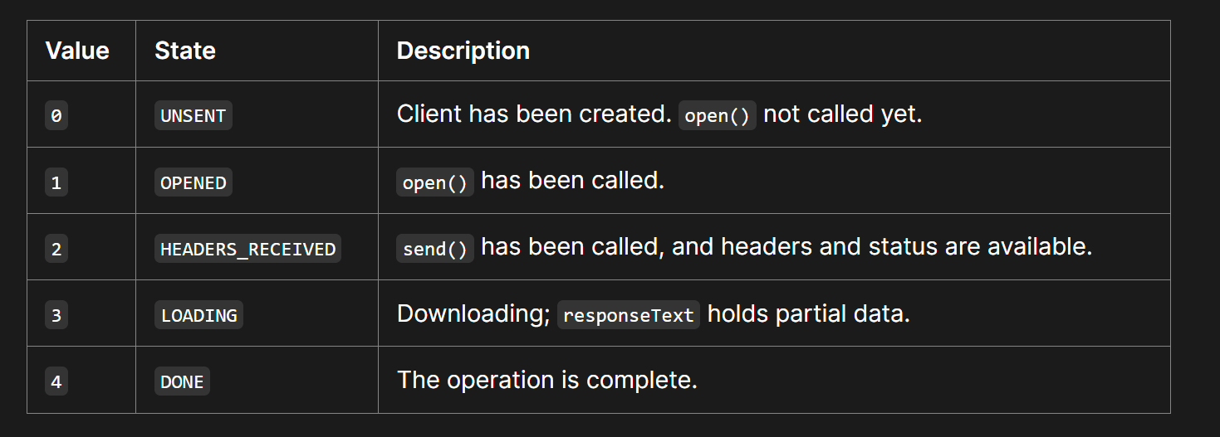






Slide 9
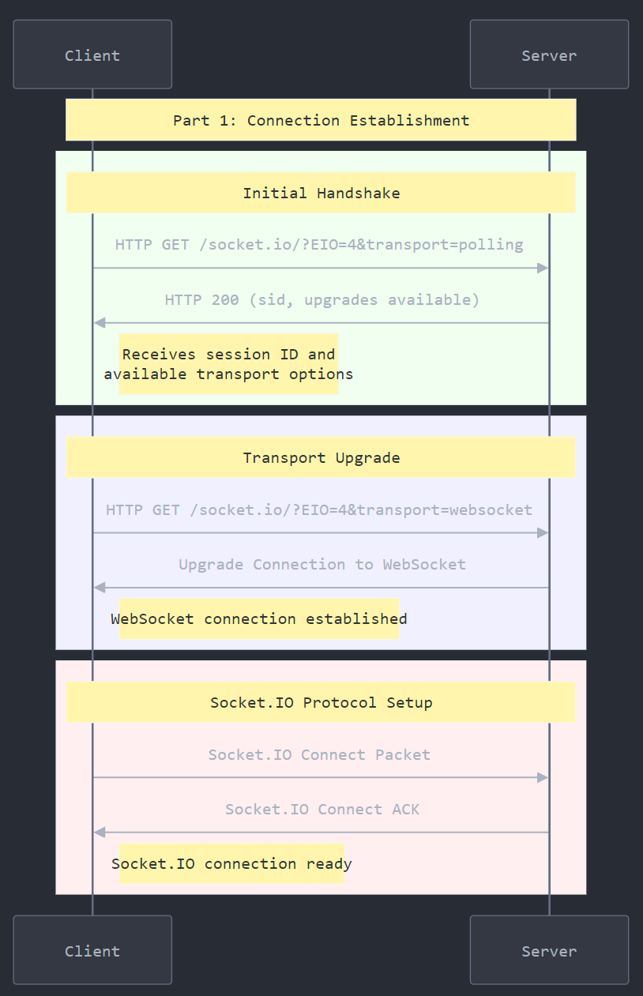
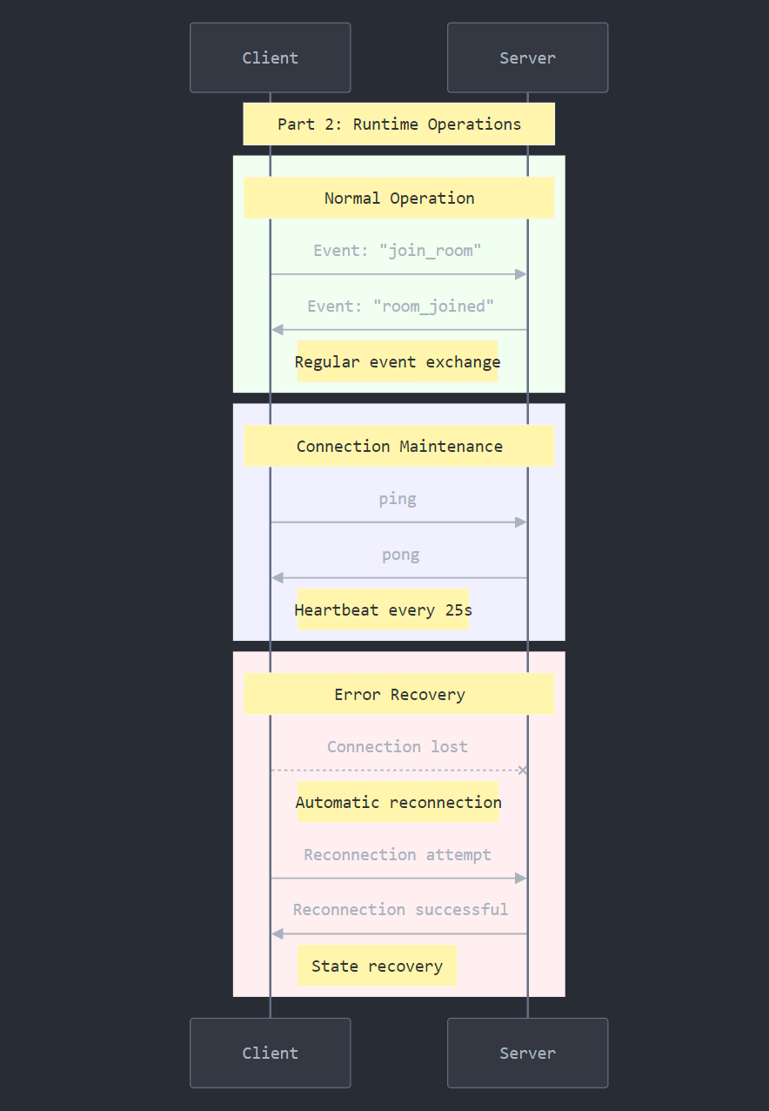

Socket.io since 2010
{ "sid": "FSDjX-WRwSA4zTZMALqx", "upgrades": ["websocket"], "pingInterval": 25000, "pingTimeout": 20000 }
The bidirectional channel between the Socket.IO server (Node.js) and the Socket.IO client (browser, Node.js, or another programming language) is established with a WebSocket connection whenever possible, and will use HTTP long-polling as fallback.

Slide 10
Upgrade HTTP to WebSocket
Server request
GET /chat HTTP/1.1
Host: server.example.com
Upgrade: websocket
Connection: Upgrade
Sec-WebSocket-Key: dGhlIHNhbXBsZSBub25jZQ==
Origin: http://example.com
Sec-WebSocket-Protocol: chat, superchat
Sec-WebSocket-Version: 13
Server response
HTTP/1.1 101 Switching Protocols
Upgrade: websocket
Connection: Upgrade
Sec-WebSocket-Accept: s3pPLMBiTxaQ9kYGzzhZRbK+xOo=
Sec-WebSocket-Protocol: chat

